Slide 1
Industrial Economics PPT - 8
Economies of Integration
Economies & Diseconomies of Scope, Economies of Integration: Vertical & Horizontal Integration, Break-Even Analysis

Slide 2
Production with Two Outputs – Economies of Scope
Many firms produce more than one product. Sometimes a firm’s products are closely linked to one another: A chicken farm, for instance, produces poultry and eggs, an automobile company produces automobiles and trucks, and a university produces teaching and research. At other times, firms produce physically unrelated products.
In both cases, however, a firm is likely to enjoy production or cost advantages when it produces two or more products.
These advantages could result from the joint use of inputs or production facilities, joint marketing programs, or possibly the cost savings of a common administration.
In some cases, the production of one product yields an automatic and unavoidable byproduct that is valuable to the firm. For example, sheet metal manufacturers produce scrap metal and shavings that they can sell.

Slide 3
Product Transformation Curves
Product Transformation Curve: Curve showing the various combinations of two different outputs (products) that can be produced with a given set of inputs.
To study the economic advantages of joint production, let’s consider an automobile company that produces two products, cars and tractors.
Both products use capital (factories and machinery) and labor as inputs.
Cars and tractors are not typically produced at the same plant, but they do share management resources, and both rely on similar machinery and skilled labor. The managers of the company must choose how much of each product to produce.
Figure 7.11 shows two product transformation curves, each showing the various combinations of cars and tractors that can be produced with a given input of labor and machinery.
Curve O1 describes all combinations of the two outputs that can be produced with a relatively low level of inputs, and curve O2 describes the output combinations associated with twice the inputs.

Slide 4
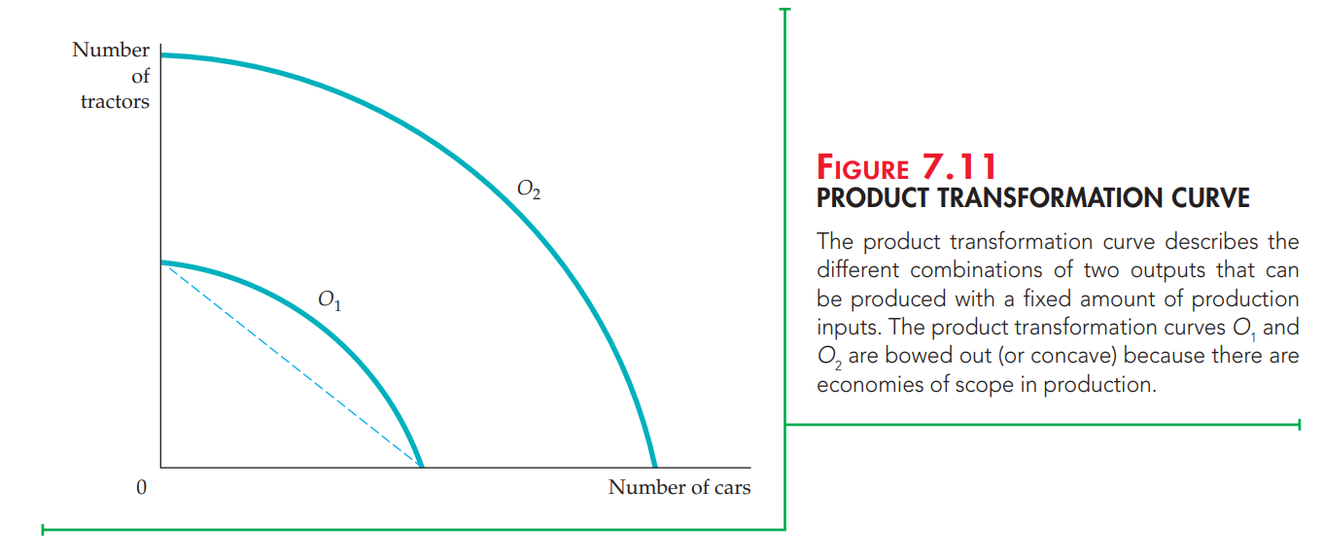

Slide 5
Why does the product transformation curve have a negative slope?
Because in order to get more of one output, the firm must give up some of the other output.
For example, a firm that emphasizes car production will devote less of its resources to producing tractors. In Figure 7.11, curve O2 lies twice as far from the origin as curve O1, signifying that this firm’s production process exhibits constant returns to scale in the production of both commodities.
The product transformation curve is bowed outward (or concave) because joint production usually has advantages that enable a single company to produce more cars and tractors with the same resources than would two companies producing each product separately. These production advantages involve the joint sharing of inputs.
A single management, for example, is often able to schedule and organize production and to handle accounting and financial activities more effectively than separate managements.

Slide 6
Economies and Diseconomies of Scope
In general, economies of scope are present when the joint output of a single firm is greater than the output that could be achieved by two different firms each producing a single product (with equivalent production inputs allocated between them).
If a firm’s joint output is less than that which could be achieved by separate firms, then its production process involves diseconomies of scope. This possibility could occur if the production of one product somehow conflicted with the production of the second.
There is no direct relationship between economies of scale and economies of scope. A two-output firm can enjoy economies of scope even if its production process involves diseconomies of scale. Likewise, a joint-product firm can have economies of scale for each individual product yet not enjoy economies of scope.
The extent to which there are economies of scope can also be determined by studying a firm’s costs. If a combination of inputs used by one firm generates more output than two independent firms would produce, then it costs less for a single firm to produce both products than it would cost the independent firms.
To measure the degree to which there are economies of scope, we should ask what percentage of the cost of production is saved when two (or more) products are produced jointly rather than individually.

Slide 7
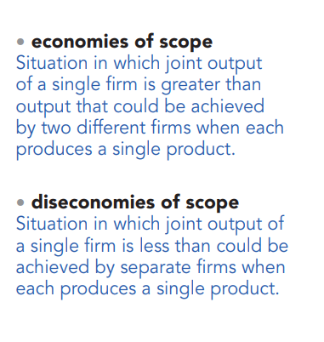
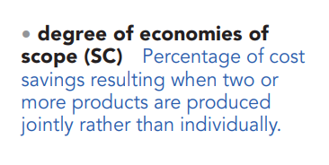

Slide 8
Economies of Integration
Development and extension are the two requirements of each firm, regardless of its size and nature. Firms can develop and grow via integration.
There are two significant types of integration; vertical integration and horizontal integration.
Horizontal integration is a sort of business development procedure, wherein the organization secures a similar business line or at a similar level of the worth chain to dispose of market rivalry or competition.
Alternately, vertical integration is utilised to take over the whole business by covering the production network. It suggests the joining or integration of different entities occupied with various phases of the conveyance chain or distribution channel.
Vertical and horizontal integration are two types of integration in external growth of firm size.

Slide 9
Horizontal Integration
The joining or integration of at least two firms, which are occupied with a similar line of business and their activity level, is known as horizontal integration. The products might incorporate by-products, complementary products, other related items, competitive products, or go into the item’s services, maintenance, and repairs section.
It refers to the merger of two firms at the same stage of production, producing the same product. For example, the merger of two car producers or two TV companies.
The primary motives behind horizontal integration are to take greater advantage of economies of scale and increase market share. Horizontal integration can also lead to rationalization and elimination of direct competitors.
Horizontal integration diminishes rivalry between firms in the market, as though the makers of the item are integrated or collaborate, they can make syndication.
It is a strategy utilised by most organisations to grow their size and accomplish economies of scale because of expanded creation or production levels. This will assist the organisation with moving toward new clients and markets. Besides, the organisation can likewise enhance and diversify its services and products.
Examples: McDonald’s, Burger King, and Facebook.

Slide 10
Vertical Integration
It occurs when a firm merges with another firm involved in the production of the same product but at a different stage of production. There are two types of vertical integration: backward and forward.
Backward integration: A firm merges with a firm that is the source of its supply of raw materials, components, or the products it sells. The main motive behind this type of integration is to ensure an adequate supply of good quality raw materials at a reasonable price.
When the organisation obtains command over its provider or supplier, then, at that point, it is upstream or in a backward combination.
Forward integration: A firm merges with, or takes over, a market outlet. The key motives behind this form of vertical integration are to ensure sufficient outlets and high-quality storage and display of products.
If the organisation obtains command over wholesalers or distributors, then, at that point, it is downstream or forward joining or forward integration.

Slide 11
The reason for joining or integration is to reinforce the production and distribution chain and to limit the expense and wastage of items at different levels.
The incorporation likewise empowers the organisation to keep downstream and upstream benefits and take out middlemen or intermediaries.
Examples: Alibaba and Apple Inc.

Slide 12
Both types of integration have their own advantages and challenges. Horizontal integration can lead to economies of scale but may also result in diseconomies of scale and management difficulties. Vertical integration helps reduce costs and wastage from the supply chain but may face challenges related to management and different sizes of merged firms.
The organisations utilise an incorporation system or integration strategy to build the market share, become more enhanced, wipe out the expense of the development of new products and services and acquaint it with the market, limiting market rivalry by assuming control over contender’s organisations, and so forth.

Slide 13
Break-Even Analysis
Break-even analysis in economics refers to the point at which total costs and total revenue are equal.
A break-even point analysis is used to determine the number of units or dollars of revenue needed to cover total costs (fixed and variable costs).
Break-even analysis is important to business owners and managers in determining how many units (or revenues) are needed to cover fixed and variable expenses of the business.

Slide 14
Break-Even Analysis Formula
The formula for break-even analysis is as follows:
Break-Even Quantity = Fixed Costs / (Sales Price per Unit – Variable Cost Per Unit)
where:
Fixed Costs are costs that do not change with varying output (e.g., salary, rent, building machinery)
Sales Price per Unit is the selling price per unit
Variable Cost per Unit is the variable cost incurred to create a unit

Slide 15
The sales price per unit minus variable cost per unit is the contribution margin per unit.
For example, if a book’s selling price is $100 and its variable costs are $5 to make the book, $95 is the contribution margin per unit and contributes to offsetting the fixed costs.

Slide 16
Break-Even Analysis Example
Colin is the managerial accountant in charge of Company A, which sells water bottles. He previously determined that the fixed costs of Company A consist of property taxes, a lease, and executive salaries, which add up to $100,000. The variable cost associated with producing one water bottle is $2 per unit. The water bottle is sold at a premium price of $12. To determine the break-even point of Company A’s premium water bottle:
Break Even Quantity = $100,000 / ($12 – $2) = 10,000
Therefore, given the fixed costs, variable costs, and selling price of the water bottles, Company A would need to sell 10,000 units of water bottles to break even.
The graphical representation of unit sales and dollar sales needed to break even is referred to as the break-even chart or cost-volume-profit (CVP) graph. The CVP graph of the example above is:

Slide 17
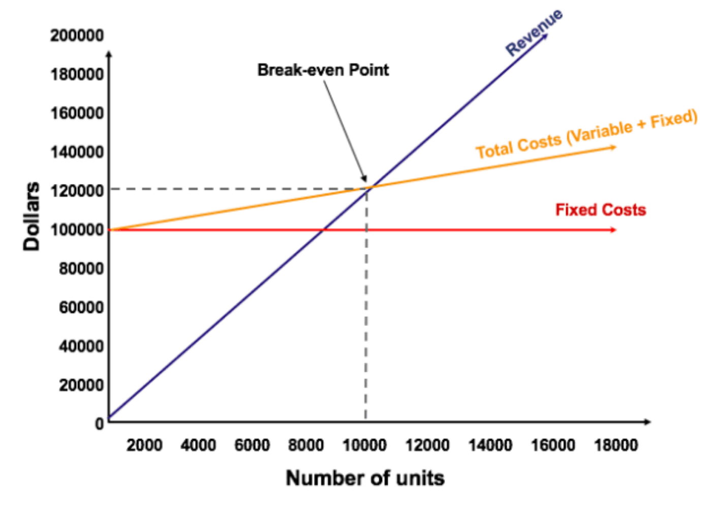
Graphically Representing the Break-Even Point

Slide 18
Interpretation of Break-Even Analysis
As illustrated in the graph above, the point at which total fixed and variable costs are equal to total revenues is known as the break-even point. At the break-even point, a business does not make a profit or loss. Therefore, the break-even point is often referred to as the “no-profit” or “no-loss point.”
The break-even analysis is important to business owners and managers in determining how many units (or revenues) are needed to cover fixed and variable expenses of the business.
Therefore, the concept of break-even point is as follows:
Profit when Revenue > Total Variable Cost + Total Fixed Cost
Break-even point when Revenue = Total Variable Cost + Total Fixed Cost
Loss when Revenue < Total Variable Cost + Total Fixed Cost

Slide 19
Every company is in business to make some type of profit. However, understanding the break-even number of units is critical because it enables a company to determine the number of units it needs to sell to cover all of the expenses it’s accrued during the process of creating and selling goods or services.
Once the break-even number of units is determined, the company then knows what sales target it needs to set in order to generate profit and reach the company’s financial goals.

